Slide 1

aniTrans
Ratheeban Rajakumar
Yves Chapuis
Roland Tschendel
Roman Alonzo
Michael Monteiro

Slide 2
Project
Customer: Animal Transport company
Create transportation routes
Changes status of orders

Slide 3
Tools
Slack
Trello
STS/Intellij
Zoom
Github

Slide 4
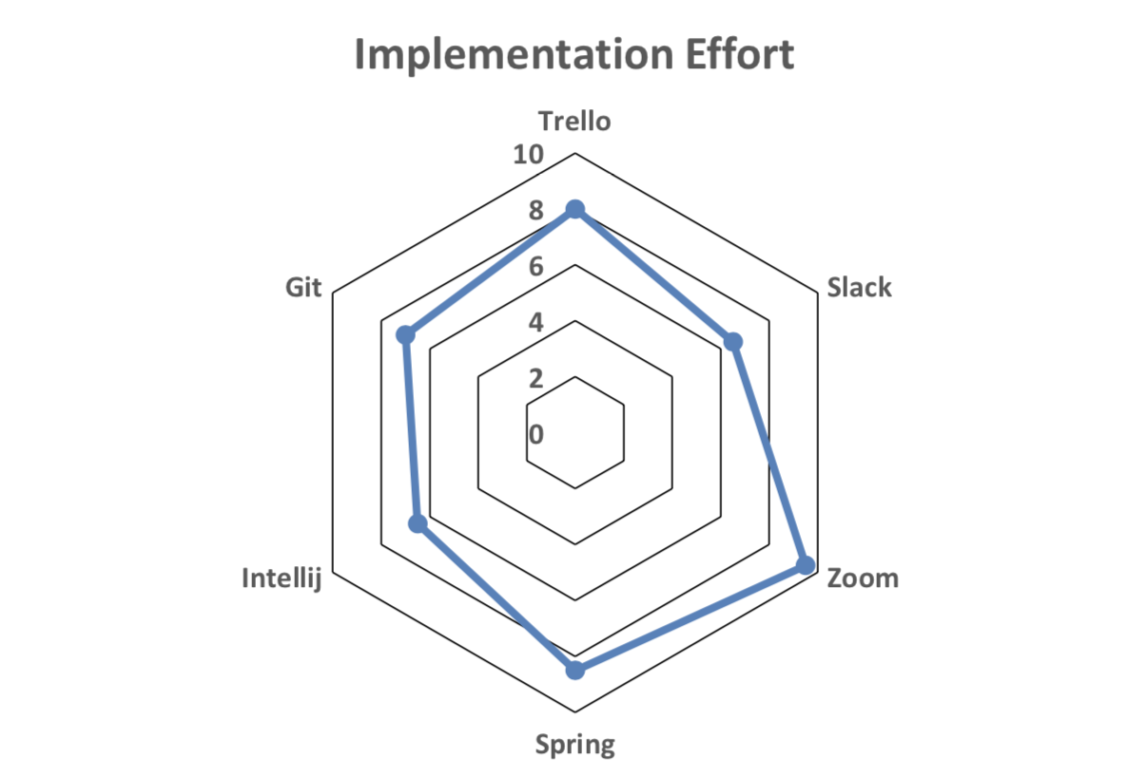
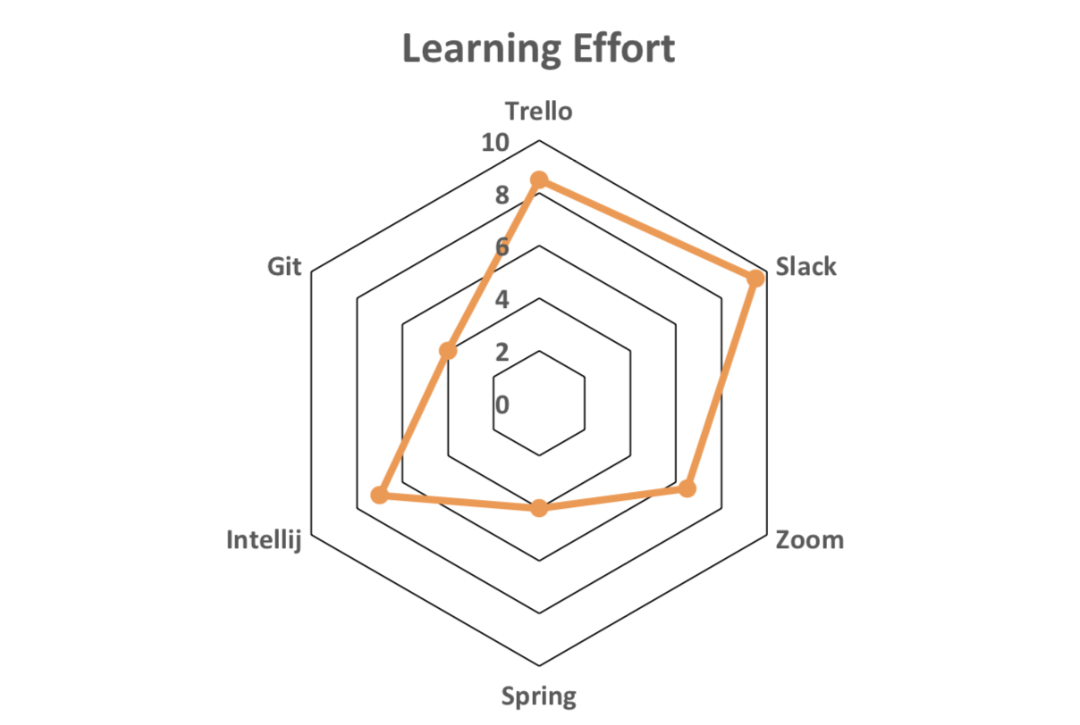
Implementation- and Learning Effort
0 = bad 10 = good

Slide 5
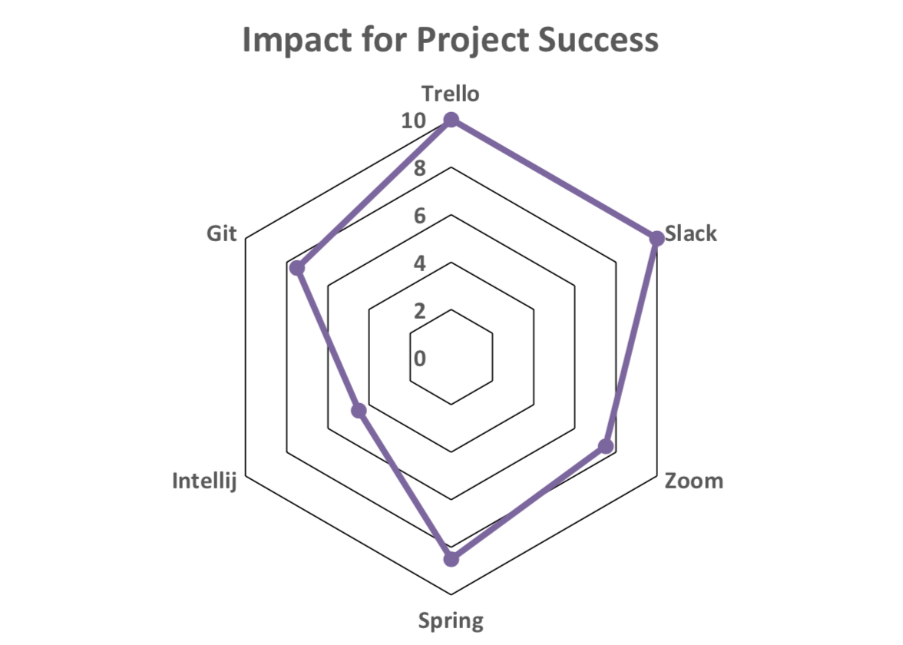
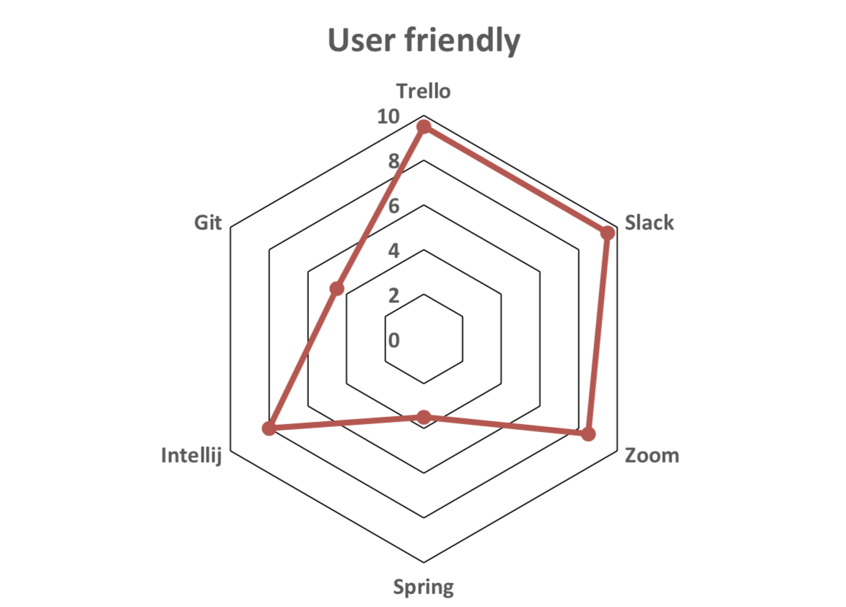
Impact for Project Success and User friendliness
0 = bad 10 = good

Slide 6
Live show

Slide 7
Positive
Trello: good tool to manage tasks
Slack: good communication tool to separate private/work
Zoom: good for screen-sharing and meetings
24/7 IT-Support by TA Mathias Fuchs
Change requests were manageable

Slide 8
Negative
Beginning: IDE was not working for everyone
Git branching knowledge was missing
Automatic testing was difficult
Planning guides from lectures were not usable to full potential
Mobile responsiveness too late

Slide 9
Conclusion
Teamwork was good
Practical knowledge combined with theory
It was difficult to find meeting times with the whole team

